Slide 1
"Digital Media Primer" Yue-Ling Wong,
Copyright (c)2013 by Pearson Education, Inc. All rights reserved.

Slide 2
Chapter 5
Capturing and Editing Digital Audio
Part 2
Digital Audio Editing

Slide 3
In this lecture, you will learn:
the basic digital audio editing steps
the common digital audio editing tools

Slide 4
Basic Editing
One audio at a time
  enhance audio (such as trimming, remove nosie) even if it is for use in audio mixing
Audio mixing with multiple audio

Slide 5
One Audio at a Time
Basic workspace elements:
Waveform display
  x-axis: time
  y-axis: audio amplitude
  mono: 1 waveform
  stereo: 2 waveforms on top of each other
Transport controls (play, record, rewind, fast forward buttons)

Slide 6
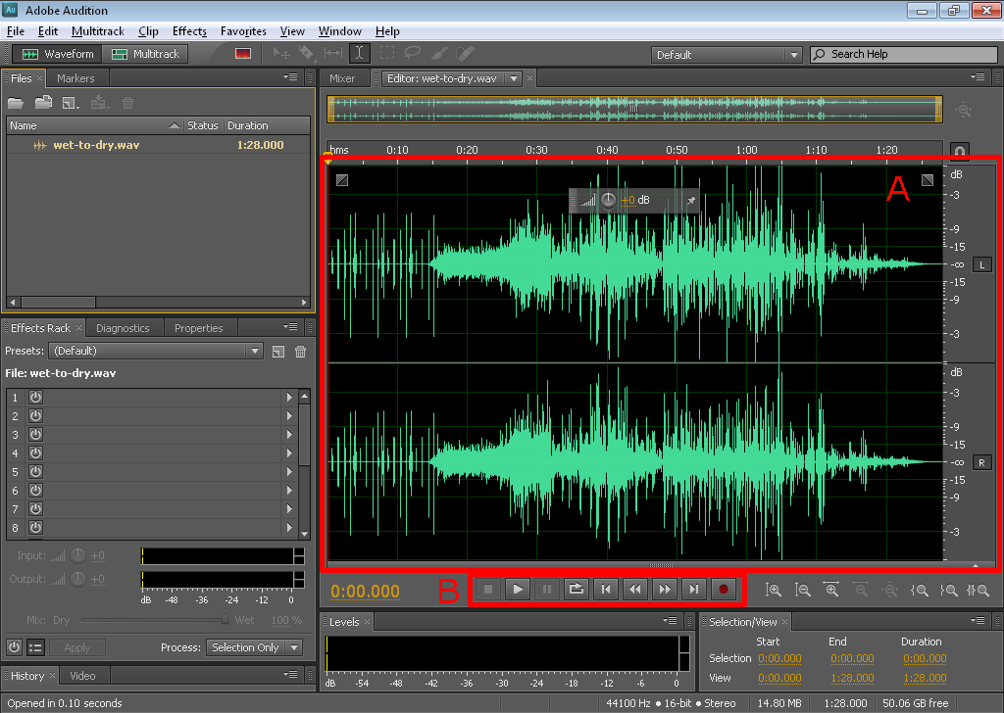
Adobe Audition
waveform display
Transport controls

Slide 7
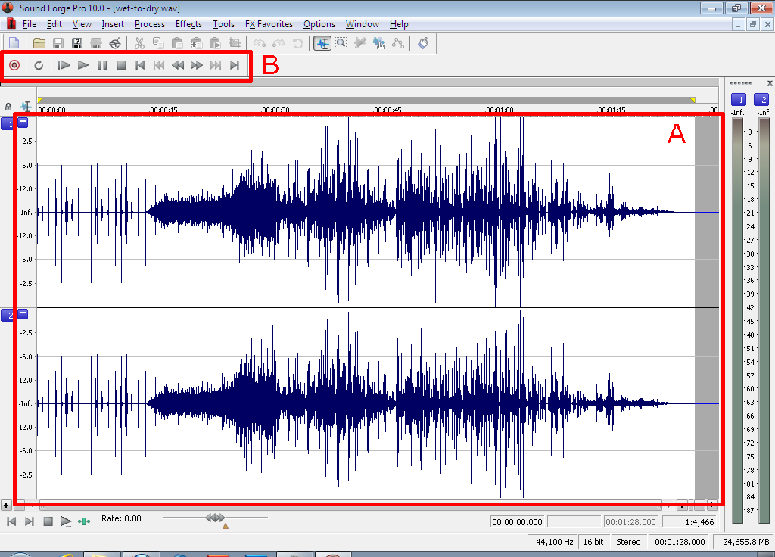
Sony Sound Forge
waveform display
Transport controls

Slide 8
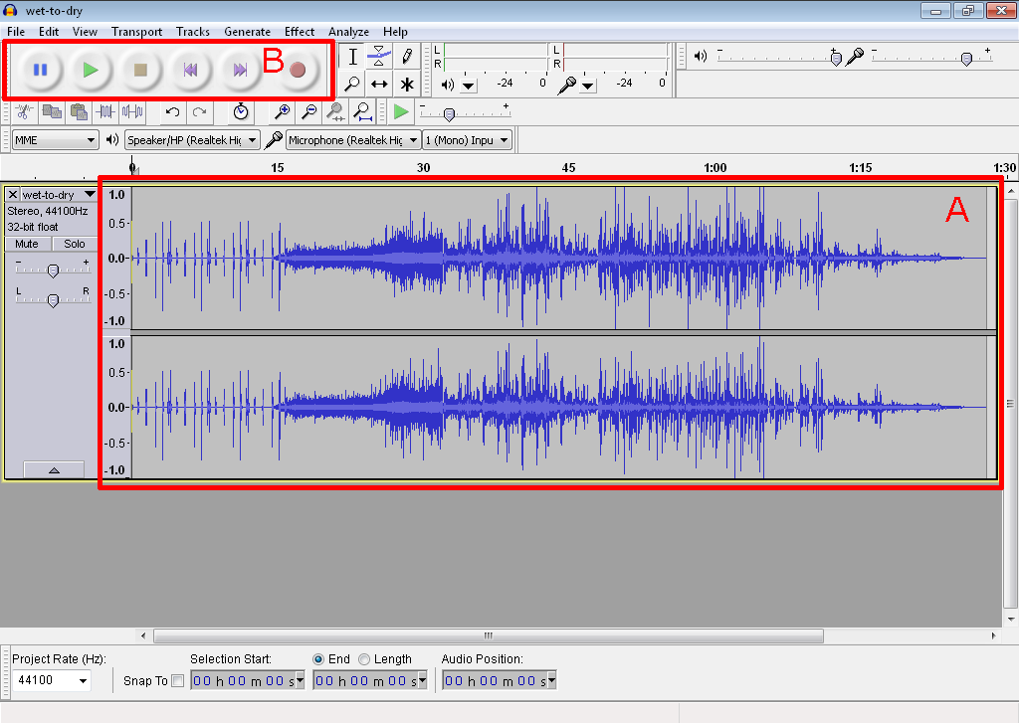
Audacity
waveform display
Transport controls

Slide 9
Audio Mixing:
Working with Multiple Audio
Example applications:
mix multiple instrumental playback where each is recorded as a separate audio
compose audio with multiple clips
voice-over with background music

Slide 10
Audio Mixing:
Working with Multiple Audio
Adobe Audition: Multitrack view
  Edit View
Audacity:
  Add audio track by choosing Project > Import Audio...

Slide 11
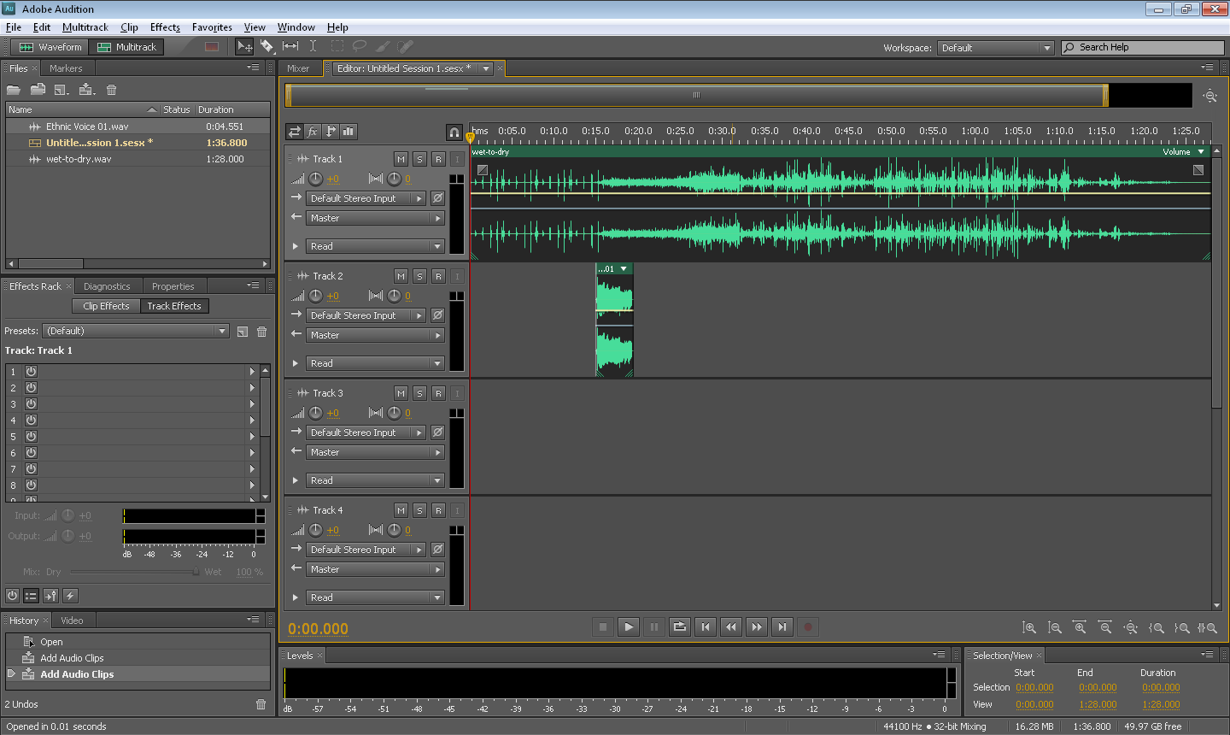
Adobe Audition
track 1
track 2

Slide 12
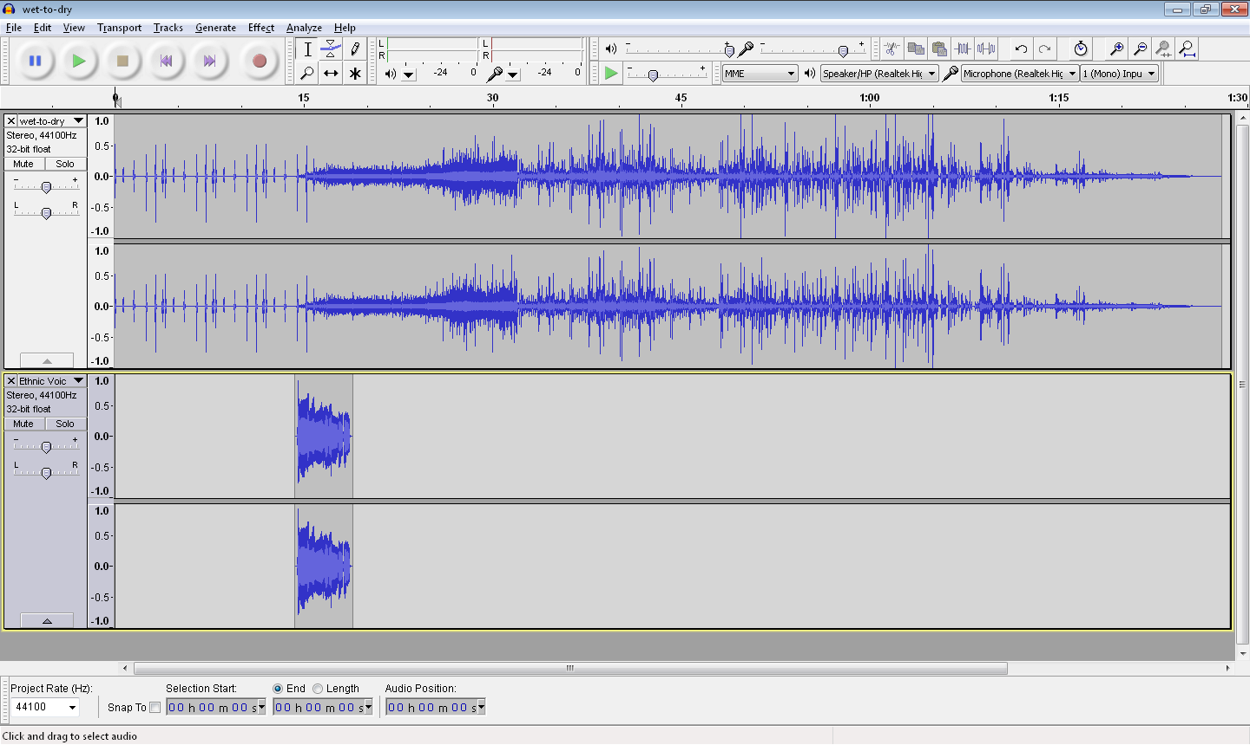
Audacity
track 1
track 2

Slide 13


Audio Mixing vs.
Recording Everything All Together
Record audio clips separately and mix them later
Record everything all together at once

Slide 14
Advantage of Audio Mixing
Allow you to adjust the volume level and apply effects (such as fade-in and fade-out) to each audio independently
Examples:
  You can adjust relative volume of the voice-over and the background music if you record the voice-over and background music as two separate audio.
  You can insert a silence in the voice-over if needed for controlling the timing.

Slide 15
Spectral View
Another representation of the digital audio in addition to waveform
 | x-axis | y-axis | color
waveform view | time | amplitude | --
spectral view | time | frequency of the audio | amplitude

Slide 16
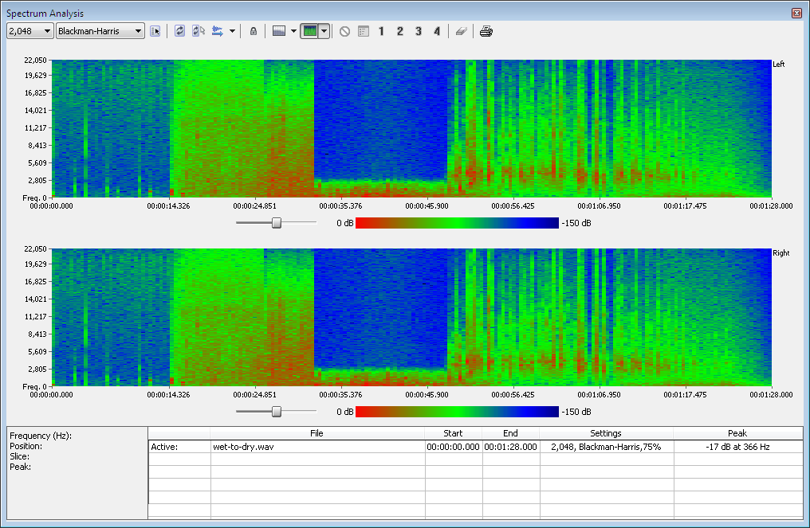
Sony Sound Forge
View > Spectrum Analysis
missing frequency higher than 3000 Hz
Note that you cannot tell the missing frequency range by looking at the waveform.

Slide 17
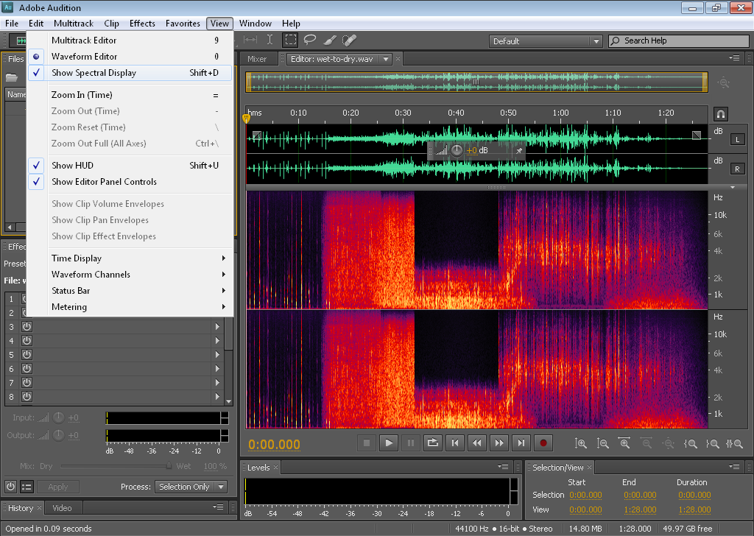
Adobe Audition
View > Show Spectral Display
missing frequency higher than 3000 Hz

Slide 18
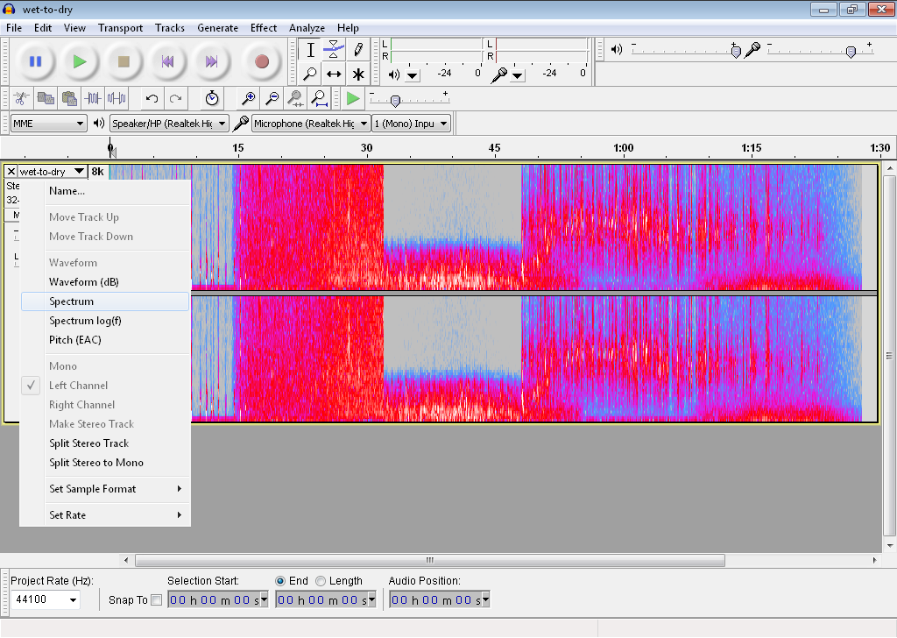
Audacity
Spectrum
missing frequency higher than 3000 Hz

Slide 19
Spectral View
Useful in:
analyzing the frequency range of the audio
selecting the frequency range of the audio
identifying audio distortion due to frequency anomaly

Slide 20
Basic Digital Audio Editing

Slide 21
Parallels between Basic Digital Image and Digital Audio Editing
Basic Digital Image Editing | Basic Digital Audio Editing
Reassemble image content by cutting, copying, and pasting | Reassemble audio waveform by cutting, copying, and pasting
Adjust tonal value | Adjust volume
Clean up dirt, dust, and scratches | Noise reduction
Resize the image | Resample the audio
Reduce the image’s color depth | Reduce the audio’s bit depth
Apply filters for special effects | Apply filters for special effects, such as reverb and pitch changes
If you want to save your file as JPEG for the Web, wait until the last step because JPEG uses lossy compression | If you want to save your file as MP3 for the Web, wait until the last step because MP3 uses lossy compression

Slide 22
Reassembling Waveform
To select a segment of a waveform:
Click-drag to select
You can cut, copy, or delete the selection
To paste a segment of a waveform:
  Click at position you want to paste
  Paste (Usually, Edit > Paste)

Slide 23
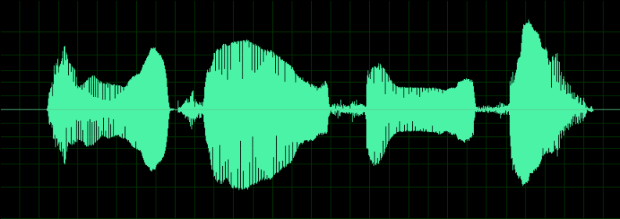
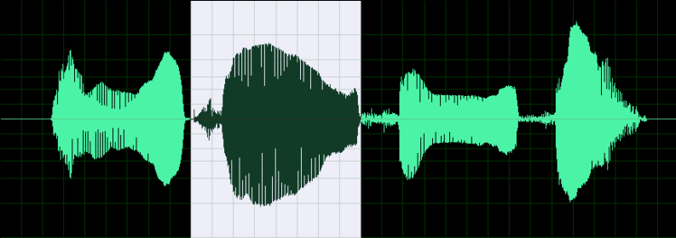
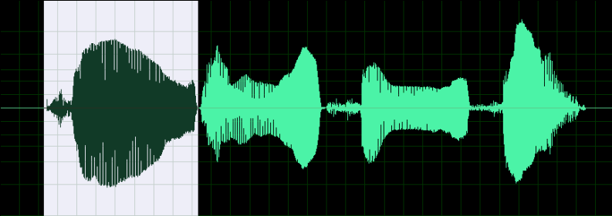
Reassembling Waveform
Example
1
2
3
4
Original recording of saying: 1 2 3 4
The segment for "2" is selected
2
1
3
4
The segment for "2" is cut and pasted before "1". Now, the audio says: 2 1 3 4

Slide 24
Changing Volume
When the original audio is too soft or too loud for the intended use
When composing multiple audio that do not have a consistent volume level—some too soft and some too loud
When you want to fade in or out an audio

Slide 25
Common Functions for
Changing Volume
Amplify:
lets you specify amplification in a dB (decibels) or percentage
Normalize:
  lets you set a peak level for a file or selection
  amplifies the entire file or selection so that the highest level is the peak level you specify

Slide 26
Common Functions for
Changing Volume
Fade in:
suppresses the volume at the beginning of the audio
Fade out:
suppresses the volume at the end of the audio
Envelope:
  lets you use a curve to specify the ups and downs of the volume over the course of the audio
  can create fade-in and fade-out effect

Slide 27
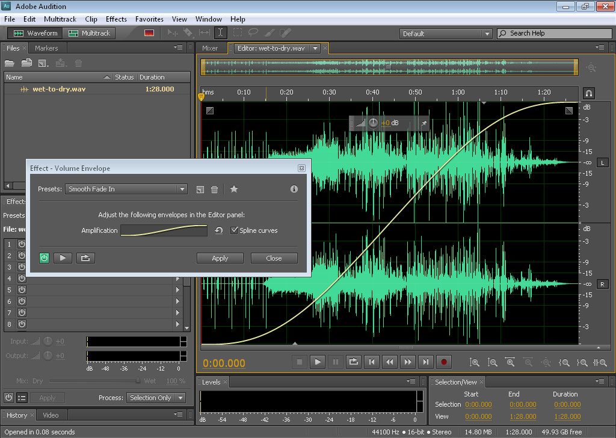
Envelope for Fade-in

Slide 28
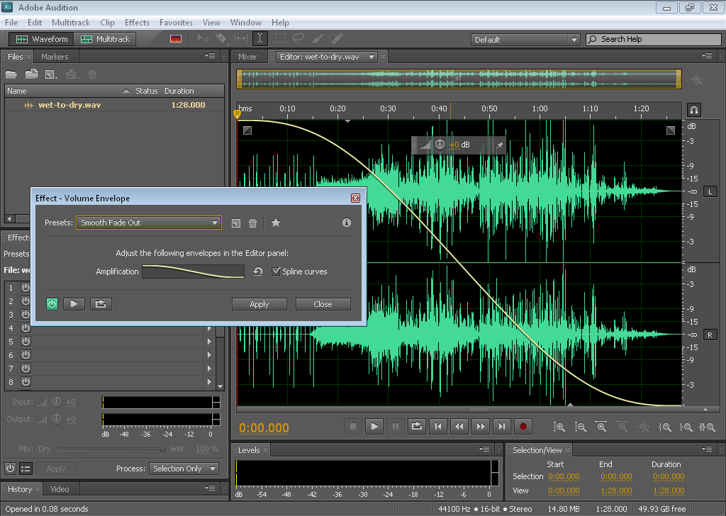
Envelope for Fade-out

Slide 29
Noise Reduction
Useful for removing background noises, such as:
computer fan noise
hissing noise of the microphone

Slide 30
Noise Reduction of Hissing
Hissing noise is often characterized by a certain frequency range
Basic idea of hiss reduction:
Suppress the amplitude for the hissing frequency range

Slide 31
Noise Reduction
To reduce noise that is constant throughout the audio
The noise may contain wide ranges of frequency

Slide 32
Noise Reduction
How it Works
You select a segment that constains pure noise.
The program performs a statistical analysis of the noise to generate a profile.
The program reduces the noise of the whole audio (or selected segment) based on the noise profile.

Slide 33
Noise Reduction in Digital Audio Programs
Adobe Audition:
Noise Reduction
Audacity:
Noise Removal

Slide 34
Special Effects
Change of pitch
  chipmunk voice (higher pitch)
  Darth Vader voice (lower pitch)
Change of speed
  helium voice (faster speed)
  slow-motion voice (slow speed)
Reverb
Create the feel from being in a large empty auditorium to a small bathroom.

Slide 35
File Size Consideration
Best to record and work with audio at CD-quality levels (i.e., 44,100 Hz sampling rate, 16-bit, and stereo) or higher
When delivering the final audio, depending on the project, you may need to lower the file size:
  downsample the file to lower the file size
  export to MP3

Slide 36
General Steps of Digital Audio-Recording Touch-up
Noise reduction
Trimming
Adjusting volume level

Slide 37
Review Questions
Note to instructor:
Depending on your preference, you may want to go over the review questions at the end of this lecture as an instant review or at the beginning of next lecture to refresh students' memory of this lecture.

Slide 38
Review Question
The x-axis of the waveform view represents the ___.
amplitude value
frequency
time
Notes:
C

Slide 39
Review Question
The y-axis of the waveform view represents the ___.
amplitude value
frequency
time
Notes:
A

Slide 40
Review Question
The x-axis of the spectral view represents the ___.
amplitude value
frequency
time
Notes:
C

Slide 41
Review Question
The y-axis of the spectral view represents the ___.
amplitude value
frequency
time
Notes:
B

Slide 42
Review Question
The color of the spectral view represents the ___.
amplitude value
frequency
time
Notes:
A

Slide 43
Review Question
___ view allows you to inspect the audio frequency distribution over time.
Waveform
Spectral
Multitrack
Notes:
B

Slide 44
Review Question
True/False: Application of special effects, such as reverb, to a noisy audio should be done before the noise reduction.
Notes:
True. Otherwise, the noise will have the special effect, which will worsen the quality of the audio.

Slide 45
Review Question
The fade-in and fade-out effects can be created by applying the ___ effect.
amplify
envelope
noise reduction
normalize
reverb
Notes:
B

Slide 46
Review Question
The ___ effect lets you change the audio amplitude.
amplify
envelope
noise reduction
normalize
reverb
Notes:
A and D

Slide 47
Review Question
The ___ effect lets you change the audio amplitude such that the highest is the amplitude you specify.
amplify
envelope
noise reduction
normalize
reverb
Notes:
D

Slide 48
Review Question
The ___ effect lets you create a feel of being in a big auditorium.
amplify
envelope
noise reduction
normalize
reverb
Notes:
E

Slide 49
Review Question
What is the order of performing noise reduction?
Select the segment of the audio you want to apply noise reduction to.
Select a segment that constains pure noise.
Have the program perform a statistical analysis of the noise to generate a profile.
Have the program reduce the noise of the selected segment based on the noise profile.
Notes:
B-C-A-D

